Slide 1
Cornerstone City Church Peninsula Plus Community Hoo Are Ya
5th October 2025

Slide 2
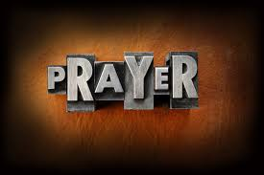

Slide 3
He Lives
CCLI Song # 7133098
Anthony Skinner | Chris McClarney | Jonathan Smith
© 2020 Capitol CMG Genesis; Be Essential Songs; Cashagamble Jet Music; Bethel Music Publishing SESAC; Thirsty Boots Music
For use solely with the SongSelect® Terms of Use. All rights reserved. www.ccli.com

Slide 4
1/8
See the tomb where He laid
See the stone rolled away
He is risen He is risen He's alive
See His hands see His feet
Touch His scars and believe
He is risen He is risen He's alive
Oh He's alive

Slide 5
2/8
He lives
All honor and power are His
All glory forever amen
Jesus (lives)
(Jesus lives)

Slide 6
3/8
Hear the shackles breaking free
Hear the song of the redeemed
He is moving He is moving He's alive
So take this freedom take this love
Can you feel it rising up
He is here He is here He's alive

Slide 7
4/8
He lives
All honor and power are His
All glory forever amen
Jesus

Slide 8
5/8
He lives
All honor and power are His
All glory forever amen
Jesus lives
Jesus lives

Slide 9
6/8
You took all our shame
Left it in the grave
We're forgiven we're forgiven
The work forever done
Only by the blood
It is finished it is finished

Slide 10
7/8
He lives
All honor and power are His
All glory forever amen
Jesus (lives)
(Jesus lives)

Slide 11
8/8
He is risen He is risen He's alive

Slide 12
Lord I lift Your Name On High
CCLI Song # 117947
Rick Founds
© 1989 Universal Music - Brentwood Benson Publishing
For use solely with the SongSelect® Terms of Use. All rights reserved. www.ccli.com
CCLI Licence No. 33265

Slide 13
1/2
Lord I lift Your name on high
Lord I love to sing Your praises
I'm so glad You're in my life
I'm so glad You came to save us

Slide 14
2/2
You came from heaven to earth
To show the way
From the earth to the cross
My debt to pay
From the cross to the grave
From the grave to the sky
Lord I lift Your name on high

Slide 15
Great Are You Lord
CCLI Song # 6460220
David Leonard | Jason Ingram | Leslie Jordan
© 2012 Open Hands Music (Admin. by Essential Music Publishing LLC)
So Essential Tunes (Admin. by Essential Music Publishing LLC)
Integrity's Praise! Music (Admin. by Integrity Music Ltd)
Little Way Creative (Admin. by Integrity Music Ltd)
For use solely with the SongSelect® Terms of Use. All rights reserved. www.ccli.com
CCLI Licence No. 33265

Slide 16
1/3
You give life You are love
You bring light to the darkness
You give hope You restore ev'ry heart that is broken
And great are You Lord

Slide 17
2/3
It's Your breath in our lungs
So we pour out our praise
We pour out our praise
It's Your breath in our lungs
So we pour out our praise to You only

Slide 18
3/3
And all the earth will shout Your praise
Our hearts will cry these bones will sing
Great are You Lord
(REPEAT)

Slide 19
1/11
Christ is my firm foundation
The rock on which I stand
When everything around me is shaken
I've never been more glad

Slide 20
2/11
That I put my faith in Jesus
'Cause He's never let me down
He's faithful through generations
So why would He fail now

Slide 21
3/11
He won’t
He won't

Slide 22
4/11
I've still got joy in chaos
I've got peace that makes no sense
So I won't be going under
I'm not held by my own strength

Slide 23
5/11
'Cause I've built my life on Jesus
He's never let me down
He's faithful in every season
So why would He fail now

Slide 24
6/11
He won’t He won't
He won't fail
He won't fail

Slide 25
7/11
Rain came and wind blew
My house was built on You
I'm safe with You
I'm going to make it through

Slide 26
8/11
I'm going to make it through
‘Cause I’m standing strong on You
I’m going to make it through
‘Cause my house is built on You

Slide 27
9/11
Christ is my firm foundation
The rock on which I stand
When everything around me is shaken
I've never been more glad

Slide 28
10/11
That I put my faith in Jesus
'Cause He's never let me down
He's faithful through generations
So why would He fail now

Slide 29
11/11
He won’t He won't
He won't fail
He won't fail

Slide 30
1/2
You won’t You won’t
You won't fail
You won't fail

Slide 31
2/2
You're a Good, Good Father
It's who You are
It's who You are
It's who You are
And I'm loved by You
It's who I am
It's who I am
It's who I am

Slide 32
1/7
I've heard a thousand stories
Of what they think You’re like
But I've heard the tender whisper
Of love in the dead of night
You tell me that You’re pleased
And that I'm never alone

Slide 33
2/7
You're a Good Good Father
It's who You are
It's who You are
It's who You are
And I'm loved by You
It's who I am
It's who I am
It's who I am

Slide 34
3/7
I've seen many searching for answers
Far and wide
But I know we're all searching for answers
Only You provide
Because You know just what we need
Before we say a word

Slide 35
4/7
You're a Good Good Father
It's who You are
It's who You are
It's who You are
And I'm loved by You
It's who I am
It's who I am
It's who I am

Slide 36
5/7
You are perfect in all of Your ways
You are perfect in all of Your ways
You are perfect in all of Your ways to us

Slide 37
6/7
Love so undeniable I can hardly speak
Peace so unexplainable I can hardly think
As You call me deeper still
As You call me deeper still
As You call me deeper still
Into love love love

Slide 38
7/7
You're a Good Good Father
It's who You are
It's who You are
It's who You are
And I'm loved by You
It's who I am
It's who I am
It's who I am

Slide 40


Slide 41
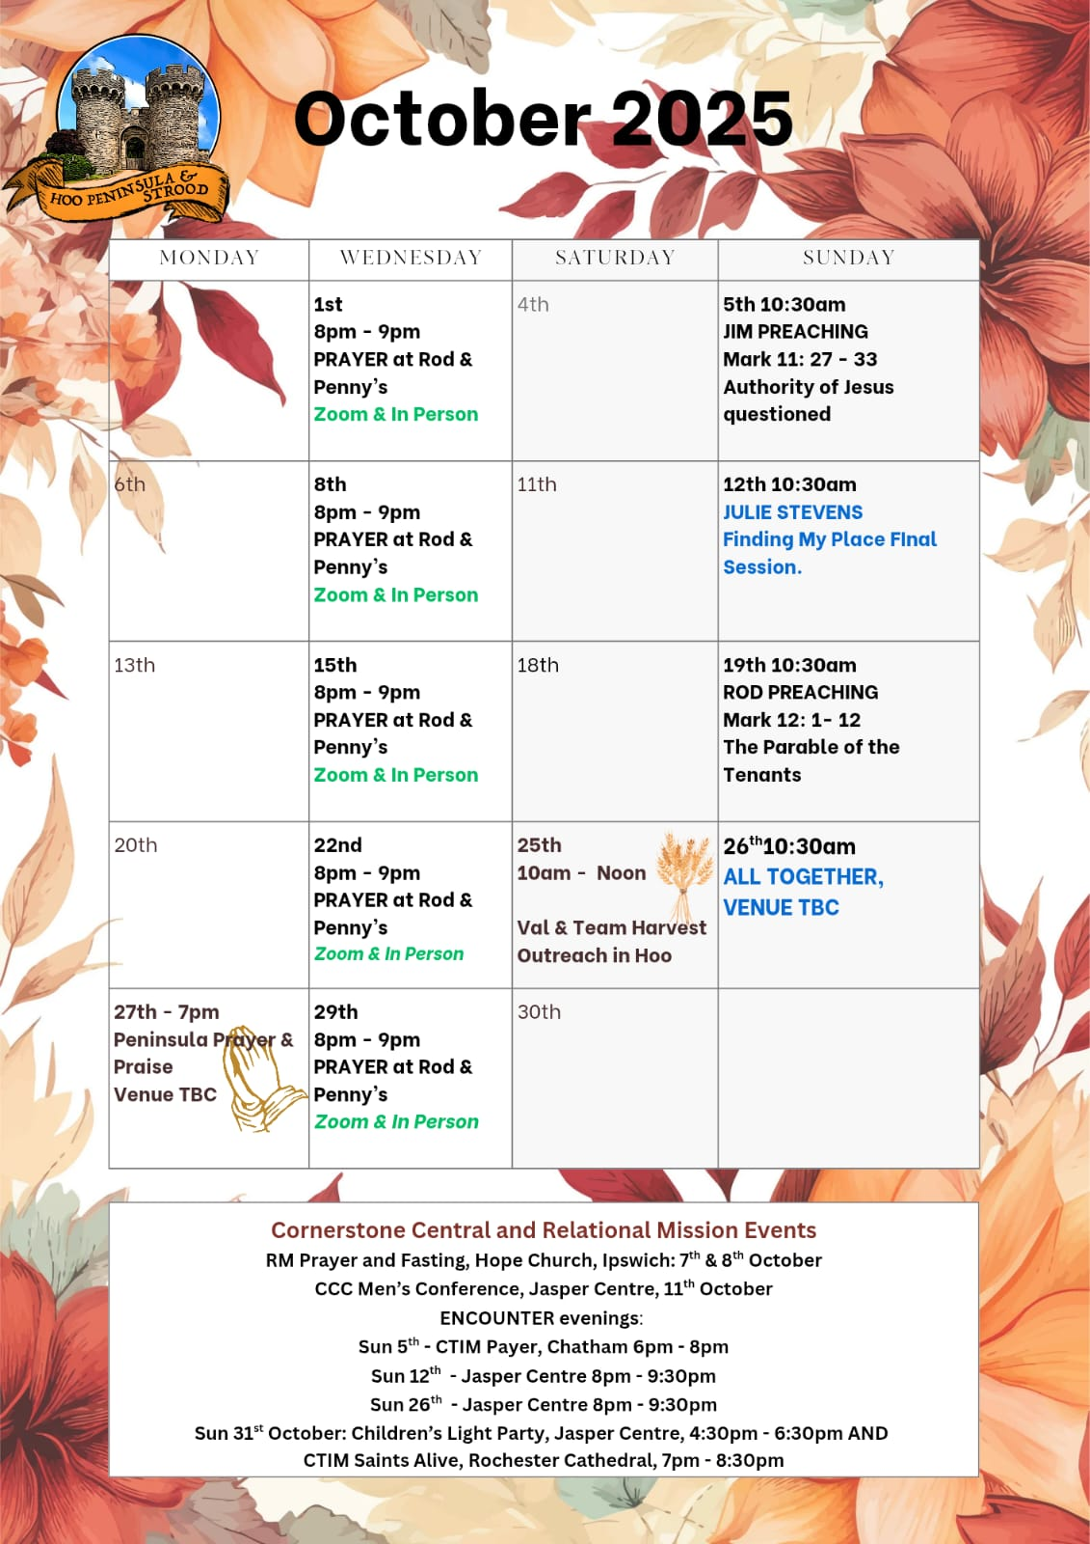

Slide 42
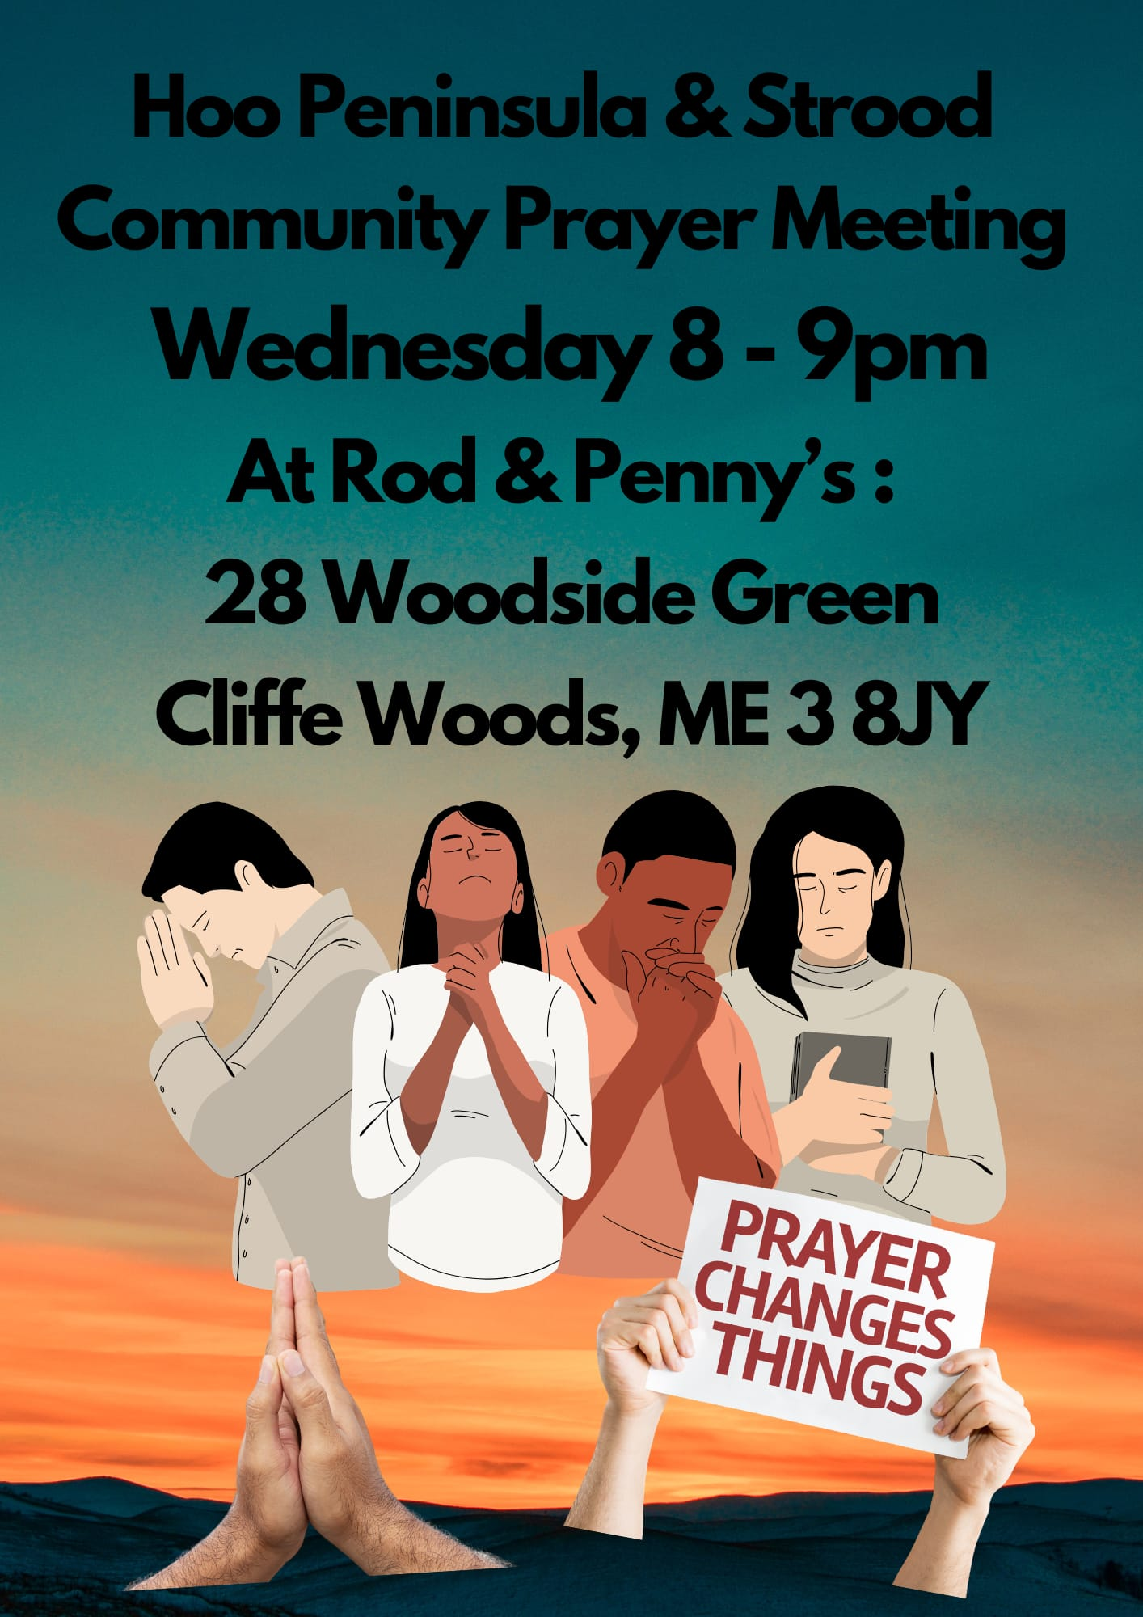

Slide 43
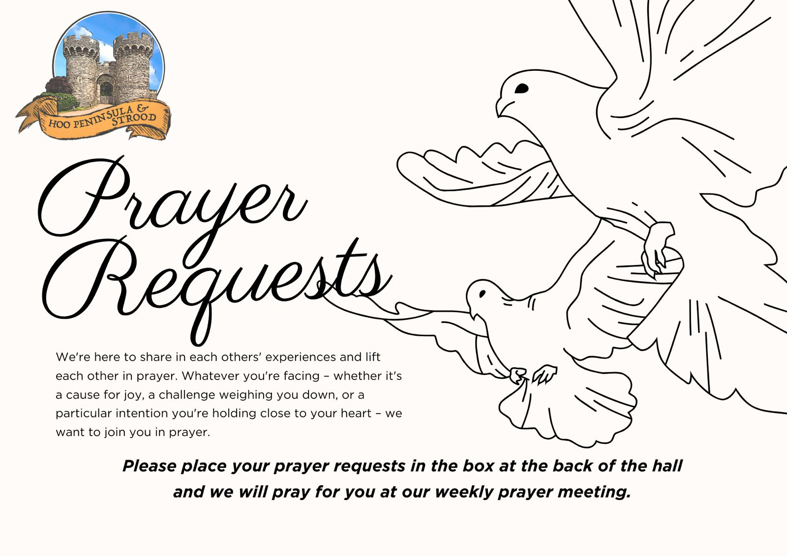

Slide 44

Grow Group 1
On YOUR MARK!

Slide 45
Leaders
Leaderss
Phil & Kim
Maria (Mia) Warren
Matthew Harrison
Richard & Elisha Acheampong
Phil & Kim
Maria (Mia) Warren
Matthew Harrison
Richard & Elisa Acheampong

Slide 46

Leaders
Phil & Kim
Maria (Mia) Warren
Matthew Harrison
Richard & Elisa Acheampong

Slide 47
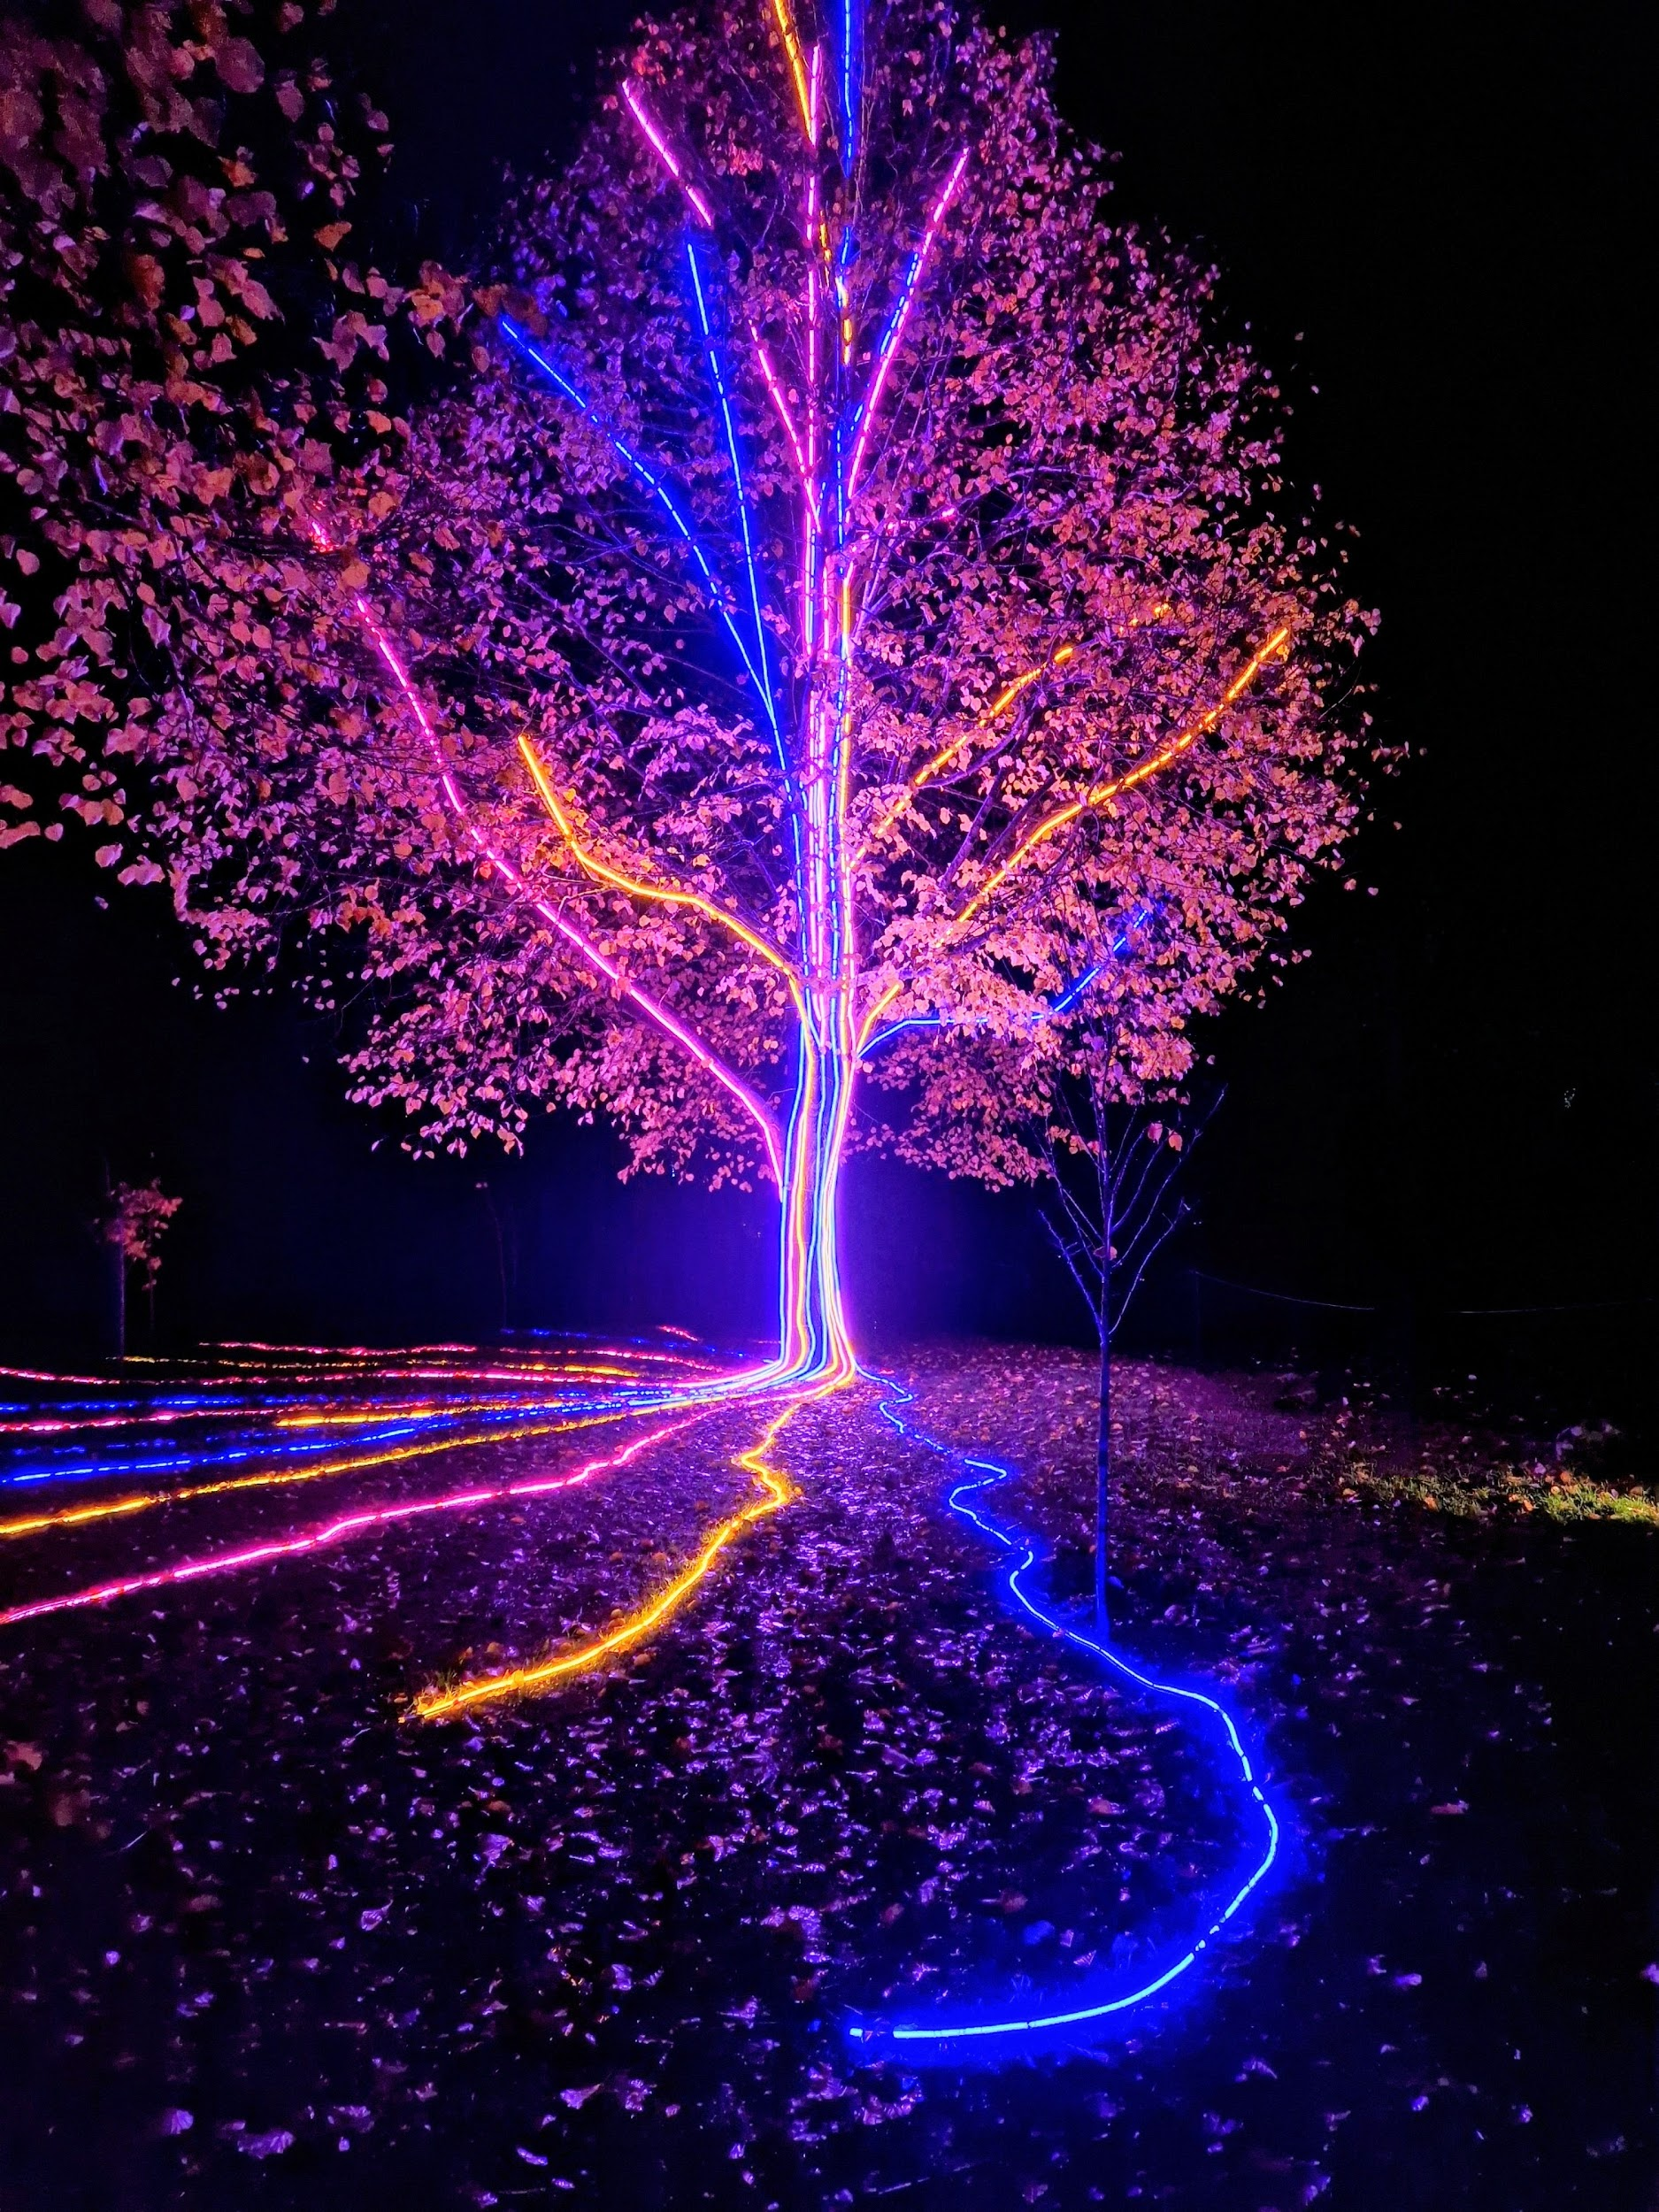
Storm Walker
Storm Walker
Symbolising, trust in Jesus Christ through life's storms.
Mark 4:35-41

Slide 48
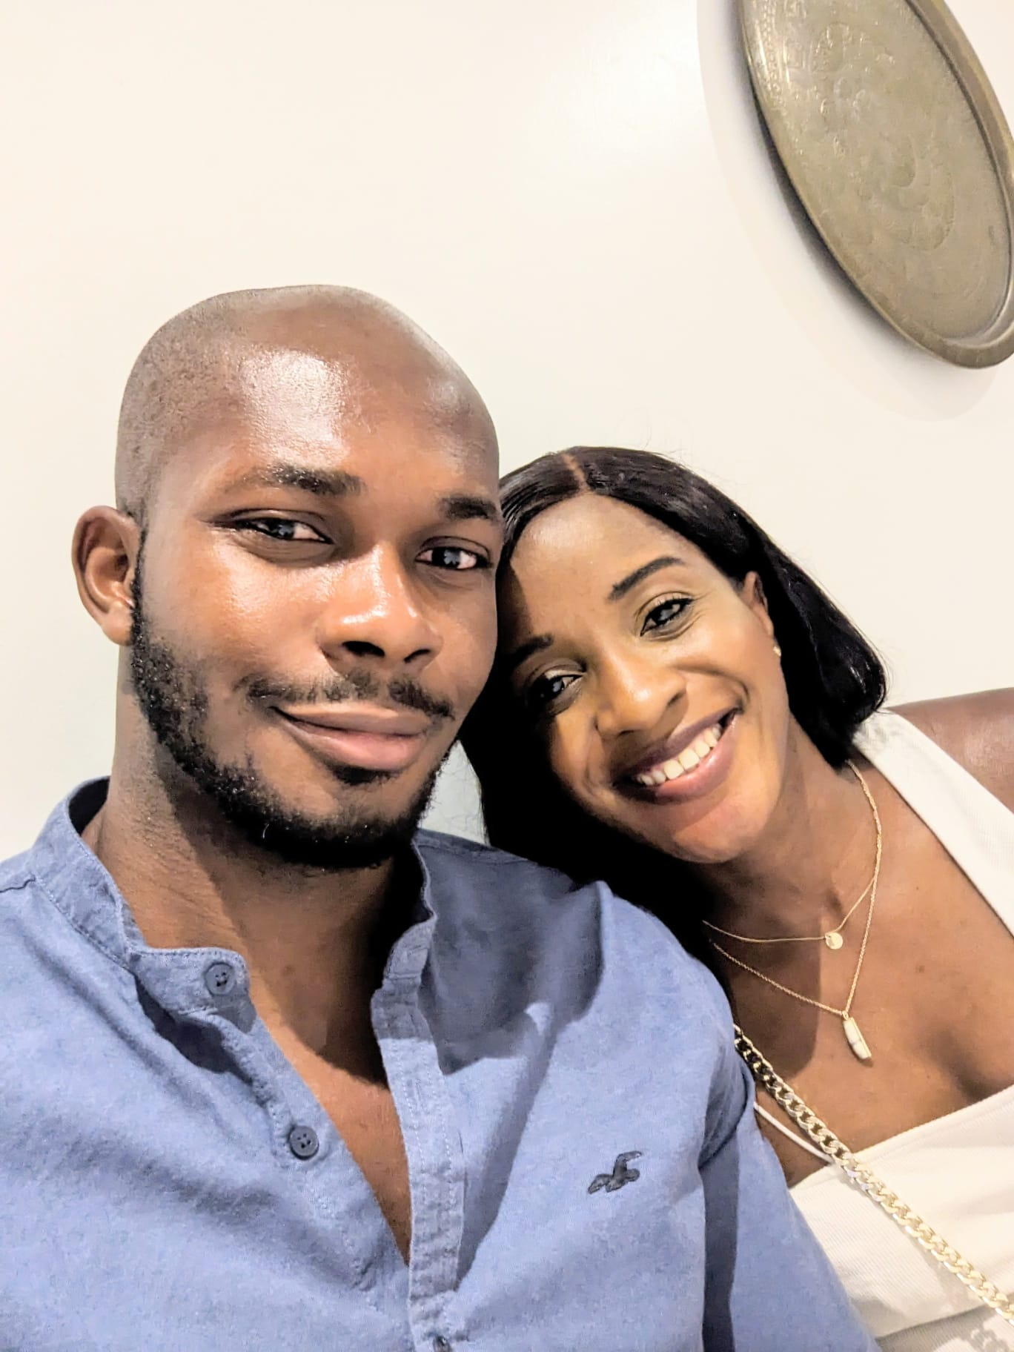

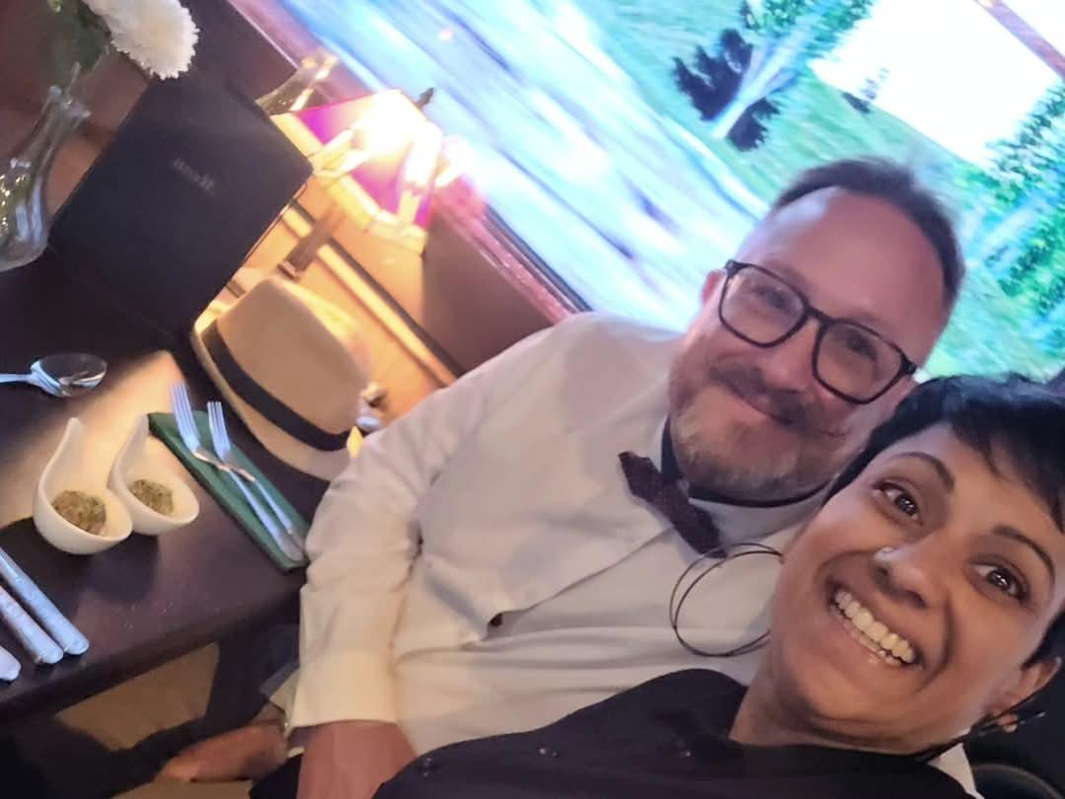
Group Leaders
Micheal and Mwamba
Wilfred and Parveen
Hannah

Slide 49
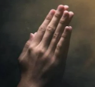
This Sunday evening is Medway Churches Together Worship & Prayer 6pm at Kings Church Chatham - Prayer for Medway and the UK.

Slide 50


Slide 51
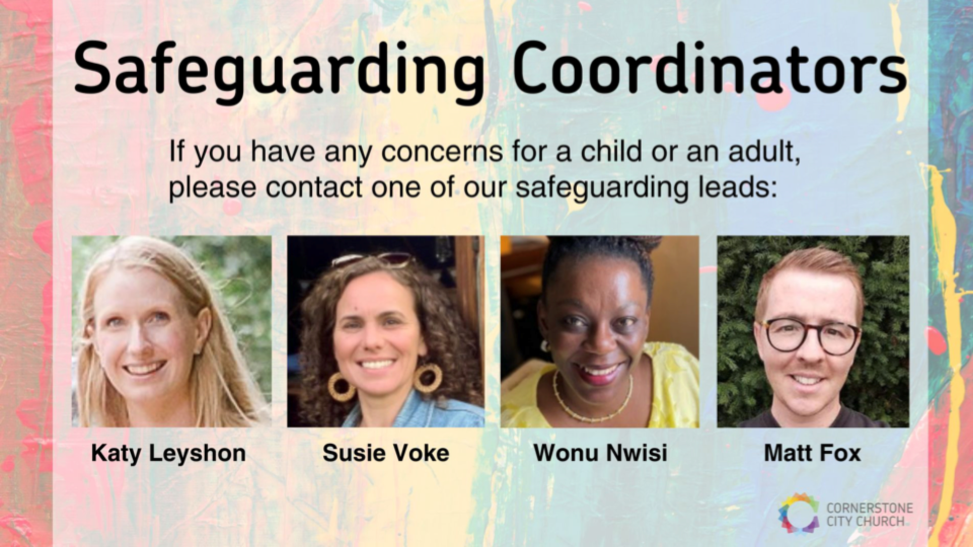

Slide 52
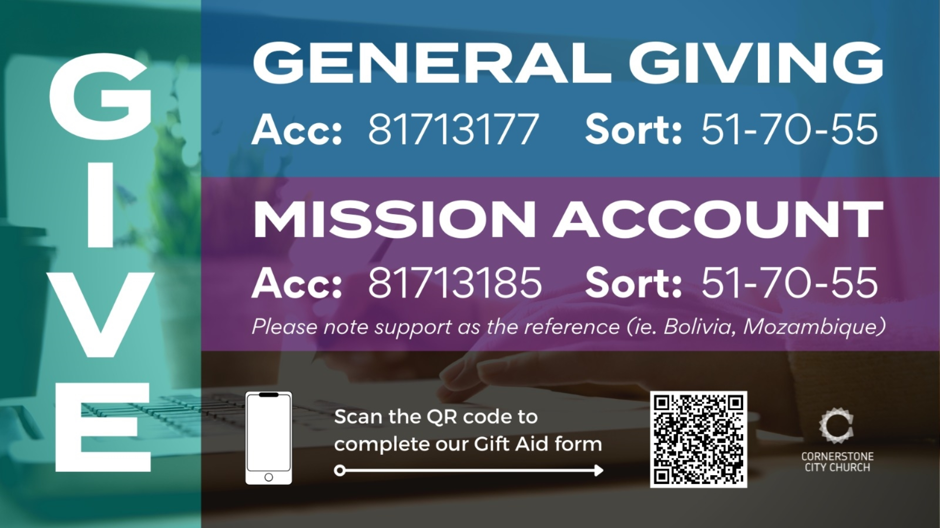

Slide 53
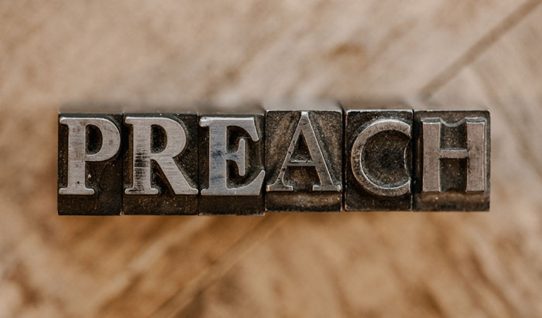

Slide 54
Behold Him
CCLI Song # 7133698
Mitch Wong | Paul Baloche
© 2019 A Wong Made Write Publishing; Integrity Worship Music; Integrity's Praise! Music; Leadworship Songs
For use solely with the SongSelect® Terms of Use. All rights reserved. www.ccli.com

Slide 55
1/7
He who was before there was light
Walked across the pages of time
He who made every living thing
Behold Him
He who heard humanity's cry
Left His throne to wake as a child
He became like the least of us
Behold Him

Slide 56
2/7
Jesus Son of God Messiah
The Lamb the roaring Lion
Oh be still and behold Him

Slide 57
3/7
He who dined with sinners and saints
Healed the blind the lost and the lame
Even now He is in our midst
Behold Him
He who chose a criminal's end
Paid with blood to settle our debt
Buried death as He rose to life
Behold Him

Slide 58
4/7
Jesus Son of God Messiah
The Lamb the roaring Lion
Oh be still and behold Him
Jesus Alpha and Omega
Our God the risen Savior
Oh be still and behold Him

Slide 59
5/7
Holy holy holy
Is the Lord God Almighty
Worthy worthy worthy
To receive all praise (REPEAT)

Slide 60
6/7
Jesus Son of God Messiah
The Lamb the roaring Lion
Oh be still and behold Him
Jesus Alpha and Omega
Our God the risen Savior
Oh be still and behold Him

Slide 61
7/7
Behold Him

Slide 62
2 Corinthians 14 May the grace of the Lord Jesus Christ, and the love of God, and the fellowship of the Holy Spirit be with you all
Surely goodness and mercy shall follow us all the days of our lives, and we shall dwell in the house of the Lord forever.

